Slide 1
Planning in the Continuous Domain: a Generalized
Belief Space Approach for Autonomous Navigation in
Unknown Environments
Vadim Indelman, Luca Carlone , and Frank Dellaert
International Journal of Robotics Research - 2015
Dan and Alon

Slide 2
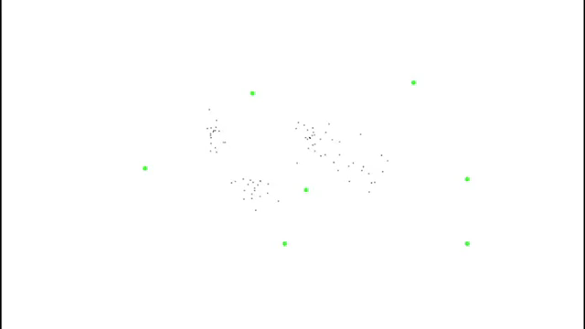
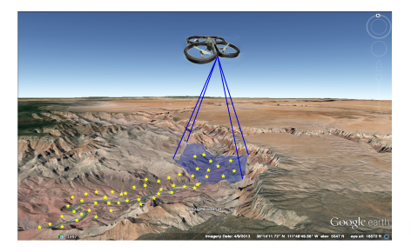

Slide 3
Mission
Reach goals without exceeding uncertainty level
Assumptions
Unknown Environments
Maximum Likelihood observations

Slide 4
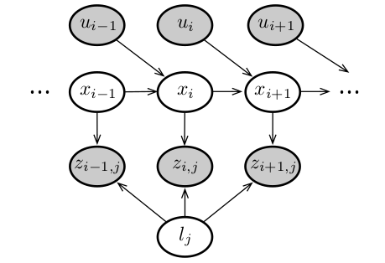
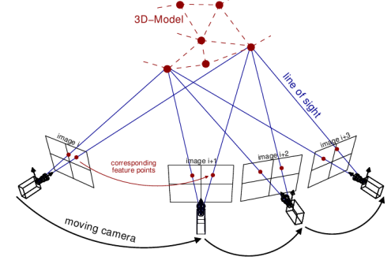
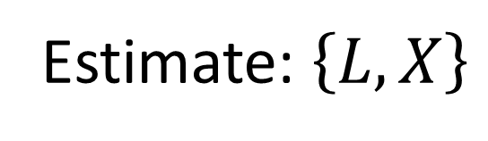

SLAM quick overview (setting)
Given: $\left\{z_{i,j},u_{i},priors\right\}$
Estimate: $\left\{L,X\right\}$

Slide 5
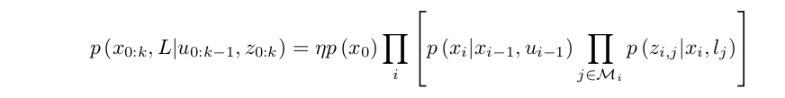
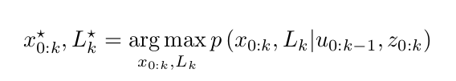
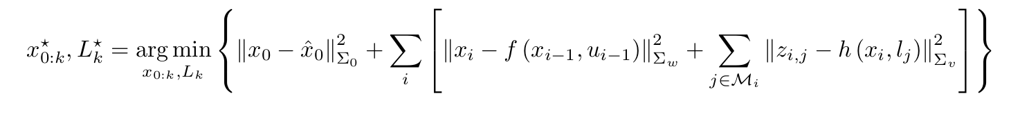
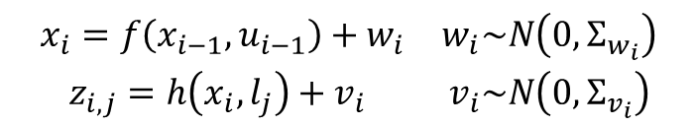
Gaussian Distribution
$$\begin{matrix}x_{i}=f\left(x_{i−1},u_{i−1}\right)+w_{i} & w_{i}\sim N\left(0,Σ_{w_{i}}\right) \\ z_{i,j}=h\left(x_{i},l_{j}\right)+v_{i} & v_{i}\sim N\left(0,Σ_{v_{i}}\right)\end{matrix}$$
Expectation Maximization

Slide 6
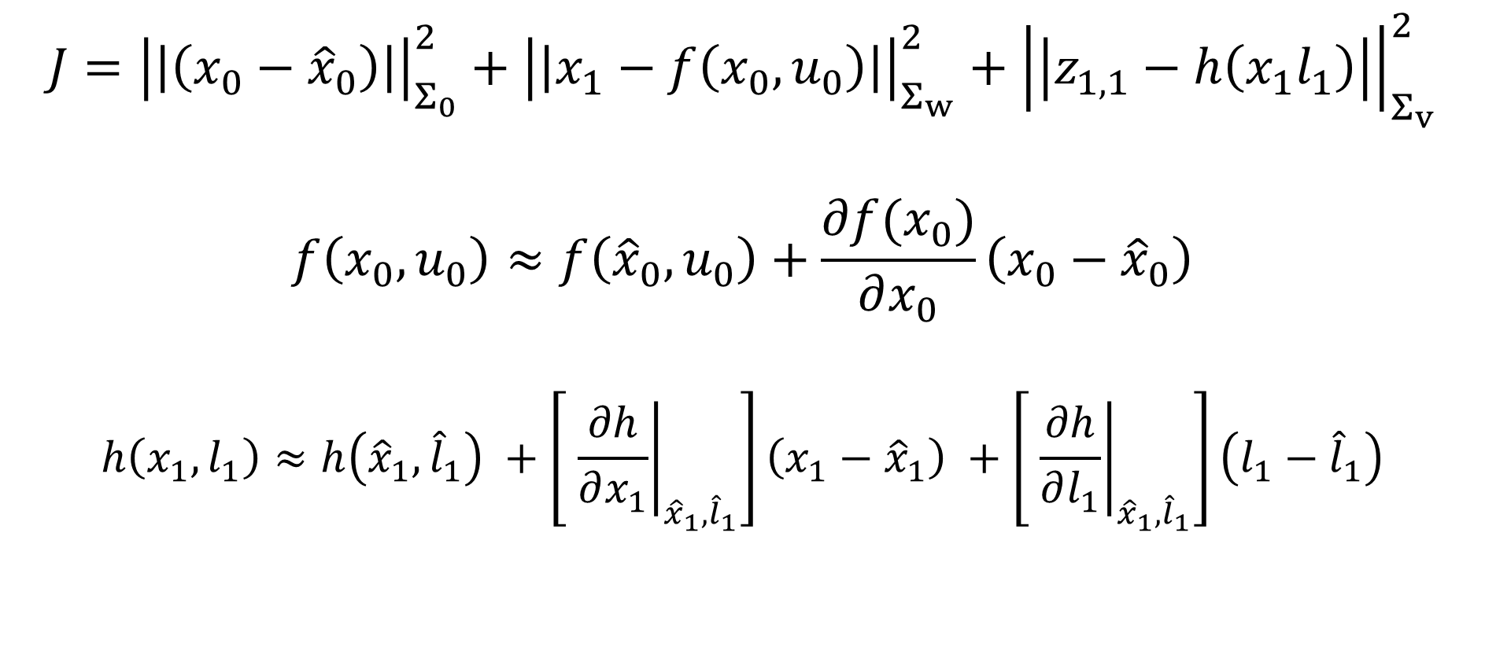
$$J={\left|\left|\left(x_{0}−{\hat{x}}_{0}\right)\right|\right|}_{Σ_{0}}^{2}+{\left|\left|x_{1}−f\left(x_{0},u_{0}\right)\right|\right|}_{Σ_{w}}^{2}+{\left|\left|z_{1,1}−h\left(x_{1}l_{1}\right)\right|\right|}_{Σ_{v}}^{2}$$
$$f\left(x_{0},u_{0}\right)≈f\left({\hat{x}}_{0},u_{0}\right)+\frac{∂f(x_{0})}{∂x_{0}}\left(x_{0}−{\hat{x}}_{0}\right)$$
$$h\left(x_{1},l_{1}\right)≈h\left({\hat{x}}_{1},{\hat{l}}_{1}\right) +\left[ {\left.\frac{∂h}{∂x_{1}}\right|}_{{\hat{x}}_{1},{\hat{l}}_{1}}\right]\left(x_{1}−{\hat{x}}_{1}\right) +\left[ {\left.\frac{∂h}{∂l_{1}}\right|}_{{\hat{x}}_{1},{\hat{l}}_{1}}\right]\left(l_{1}−{\hat{l}}_{1}\right)$$

Slide 7
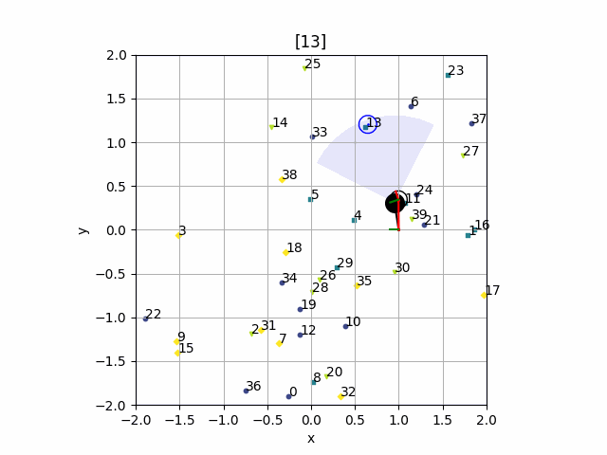

Slide 8
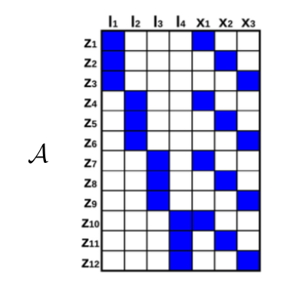

Slide 9
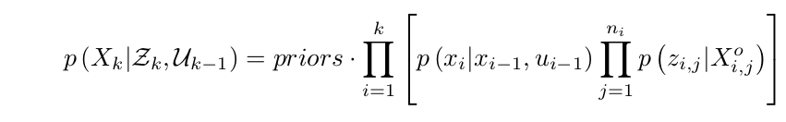
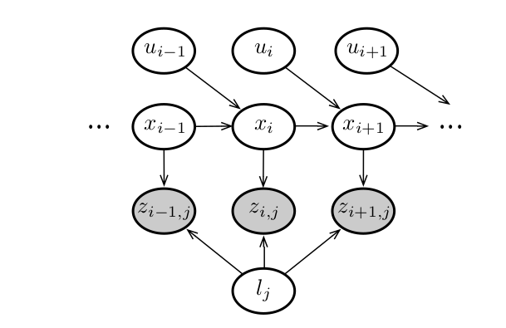
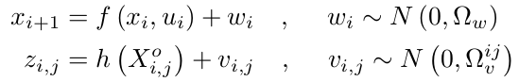

Slide 10
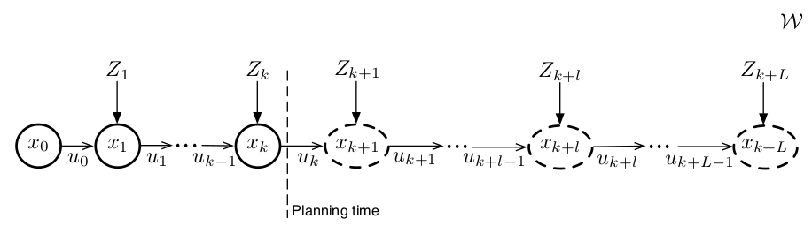
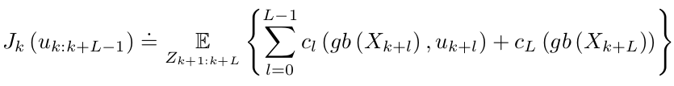
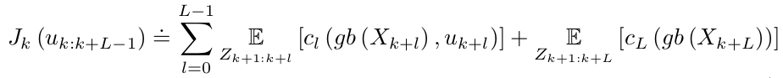

Slide 11
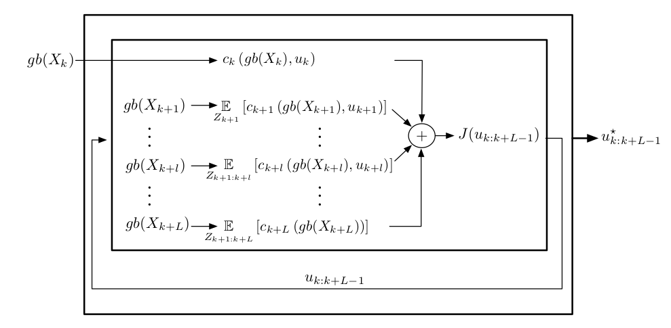
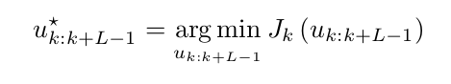
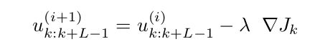

Slide 12
